Slide 1
Exam 3 review Acid/Base Equilibria and Solubility Equilibrium
Grace 11/5/18

Slide 2
Acid/Base Equilibria

Slide 3
Solubility Equilibria

Slide 4
Buffers
Definition
A solution that resists pH change
Composition (2 species)
Acid buffer: Weak acid and its conjugate base/salt (HA and A-)
Base buffer: weak base and its conjugate acid/salt (B and BH+ )
Buffer capacity:
The total amount of acid or base that can be added to the buffer before neutralizing all of one of the forms of the compound
Note: It is all about the total moles of each species in the buffer!
For equal volume solutions, more conc = higher capacity
For equal conc., greater volume = higher capacity
Example: Same buffer with equal concentration, 50mL of this buffer has double capacity value than that of 25mL buffer

Slide 5
Common strong/weak acid/base
Common weak acids
Common strong acids
Strong Acids
Hydrochloric acid (HCl)
Hydrobromic acid (HBr)
Hydroiodic acid (HI)
Perchloric acid (HClO₄)
Chloric acid (HClO₃)
Sulfuric acid (H₂SO₄) (Only the first proton is strong)
Nitric acid (HNO₃)
Common strong bases: NaOH, KOH, Mg(OH)₂, Ba(OH)₂
Common weak base: NH₃ and various amines (neutral R-NH₂, deprotonated form R-NH⁻, neutral R-NH or RN)

Slide 6
Buffers
How does a buffer work?
A buffer has both acid and base species
When H⁺ added, the base species in buffer will react to make conjugate acid, thus slowing down the increase of free H⁺ in solution, resisting dramatic pH drop
When OH⁻ added, the acid species in buffer will react to make conjugate base, thus slowing down the increase of free OH⁻ in solution, resisting dramatic pH increase
Make a buffer
1. Mix the conjugate pair
HA and A⁻ or B and BH⁺
Partial neutralization
Start with a weak acid/base and add strong acid/base in a limiting amount

Slide 7
H-H equation
$$pH=pK_{a}+\log\left(\frac{\left[A^{−}\right]}{\left[HA\right]}\right)$$
$$pOH=pK_{b}+\log\left(\frac{\left[BH^{+}\right]}{\left[B\right]}\right)$$
Used to calculate pH of a buffer
Relates pH and pKa/pKb numbers
How could I better memorize this?
$pH=pK_{a}+\log\left(\frac{[Base]}{\left[Acid\right]}\right)$ Here [base] means [conjugate salt A⁻]
$pOH=pK_{b}+\log\left(\frac{\left[Acid\right]}{\left[Base\right]}\right)$ Here [Acid] means [conjugate salt BH⁺]
So it is always the salt form on top as numerator!

Slide 8
Calculate pH of a buffer
Reaction between the species mixed together?
No: Use the H-H equation directly
Yes:
(1) Find limiting reagent
(2) Write down the neutralization reaction, Calculate the amount of conjugate pair (as leftover reactant, resulted product using RICE table)
(3) Use H-H equation
Note: The amount of conjugate species could come from two sources: (1) Reactant/product of the neutralization reaction, (2) pre-added weak acid/base/salt in the solution, remember to add them up together

Slide 9
Titration
Definition: procedure in which a strong acid/base of accurate concentration is added stepwise in small amounts (aliquots) to incrementally neutralize a solution
Performed to either determine K or measure the concentration of an unknown
Other definitions
Analyte- the “unknown” solution for which you would like to know the concentration (the stuff in the beaker)
Titrant- the “known” solution which you are using to determine the unknown (the stuff in the burette)
Indicator- compound that changes the color of the solution used to determine when the pH has undergone changes

Slide 10
Titration
Equivalence point: point in a titration at which stoichiometric amounts of acid and base have reacted (perfect neutralization)
Half equivalence point: point at which exactly half of the original analyte has been neutralized (pH = pKa at this point)
Example: If I used 10mL titrant NaOH(aq) at equivalence point, Half equivalence point is when 5mL NaOH(aq) is added.
End point- point at which an indicator changes color→ Stop titration
DIFFERENCE = TITRATION ERROR.
We want to minimize this difference→ Proper choice of indicator

Slide 11
Indicators
Special types of weak acids or bases that have different colors when protonated or deprotonated
Only requires 1-2 drops (Conc<< 0.001M)
The color is very intense to be visible
Doesn’t impact pH or overall concentration because quantity is so minute
Choice of indicator?
changes color close to the equivalence point pH
An appropriate indicator should have a pKa:
pH(equivalence point)= pKa±1

Slide 12
Polyprotic acids
Acids with more than one acidic proton
Each proton has its own equilibrium (multiple Ka’s)
One proton comes off completely before the next
H₃PO₄ is a great example
Fraction of species diagram for diprotic
$f_{A^{2−}}=\frac{\left[A^{2−}\right]}{\left[H_{2}A\right]+\left[HA^{−}\right]+\left[A^{2−}\right]}$

Slide 13
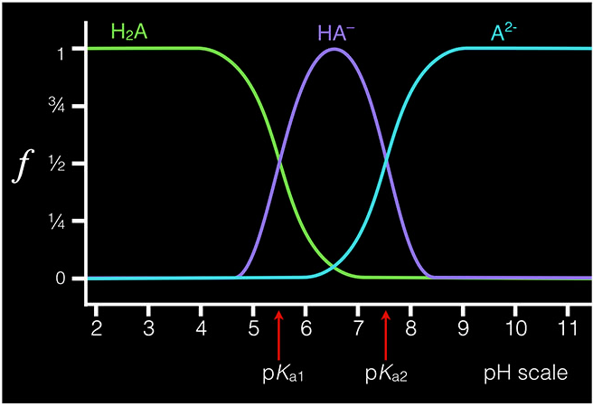
Dominant species @ a pH
If you find a molecule in solution, does it have a particular proton attached, or is the proton free in solution?
Use the curve:

Slide 14
Solubility Equilibria
Ksp: The product of the equilibrium concentrations of ions in a SATURATED solution of an ionic compound
Ion Effect on Solubility Product Constants
Ksp is fixed for a given salt at a given temperature, if we have ions in solution already, the salt will dissolve less

Slide 15
Examples: #1. Indicator choice
Key: 1 is correct
An appropriate indicator should have a pKa:
pH(equivalence point)= pKa±1
At equivalence point when you have neutralization with stoichiometric HBr(strong acid) added, you have only NH₄Br(acidic salt) in solution, which means pH of this solution at equivalence point is less than 7. So the indicator should change color at the acidic range.
Correction: We cannot calculate the pH at equivalence point as a specific number, as we do not have initial concentration given (Recall what we do to calculate the pH of a salt in exam 2 using quadratic equation)
K_{b} is given to tell you NH₃ is a weak base.

Slide 16
Examples: #2. Dominant species
H₂A
HA⁻
Key: 1 is correct
You have mostly HA- in your solution

Slide 17
Examples: #3. Polyprotic acid
Key: 3 is correct
For a triprotic acid, K_{a3} will describe the 3rd deprotonation event.
If I have H₅X, K_{a3} will still describe the 3rd deprotonation event!

Slide 18
Examples: #4. Ksp (x to Ksp)
Key: 1 is correct
$$M3X ⇌ 3M++ X3−$$
0 | 0 | 0
x | 3x | x
x | 3x | x
Ksp$=\left[M3+\right]3\left[X3−\right]$
$=$ [3x] $3\text{[}\text{x}\text{]}$
$=$ 27*x⁴
x = 2*10⁻⁶ M
Ksp= 4.32* 10⁻²²
Look for the actual concentrations of [M³⁺] and [X³⁻] in solution. Here we have M³⁺ and X³⁻ solely resulted from dissolving x amount of M₃X, so we are using 3x and x for their concentrations.

Slide 19
Examples: # 5. Ksp (Ksp to x)
Key: 1 is correct
Note: 1. This is the spectator ion case, think about ion effect to suppress the dissolving of the compound.
2. Ksp is fixed for a given species @ fixed temperature
3. Look for actual concentration of [OH⁻] in solution. Get this from the pH in this case.
We are not using 2x for [OH⁻], as the OH⁻ present in solution is not simply resulted from dissolving x amount of Zn(OH)₂. [OH⁻] is decided by the pH of the solution buffered.

Slide 20
Examples: # 6. H-H equation
Calculate the pH of a buffer solution that is .25 M in NaClO and .15 M in HClO ($K_{a} for HClO=3.5∗{10}^{−8})$
Note we don’t care about the volume!
From Ka, we can calculate $pK_{a}=$7.46 for HClO
$pH={pK}_{a}+\log{\frac{\left[base\right]}{\left[acid\right]}}$
$pH=7.46+\log{\frac{\left[.25\right]}{\left[.15\right]}}$
$pH=7.68$

Slide 21
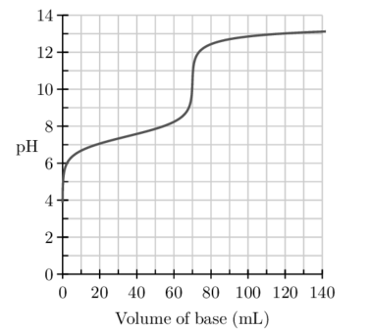
Examples: # 7. Titration practice (reading curves)
What is being titrated?
(strong/weak acid/base with a strong/weak acid/base. Mono or polyprotic?)
This is the titration of a weak monoprotic acid with a strong base
What is the pH at the equivalence point?
~10
What is the approximate pKa?
~7.5
This is the half-equivalence point

